Slide 1
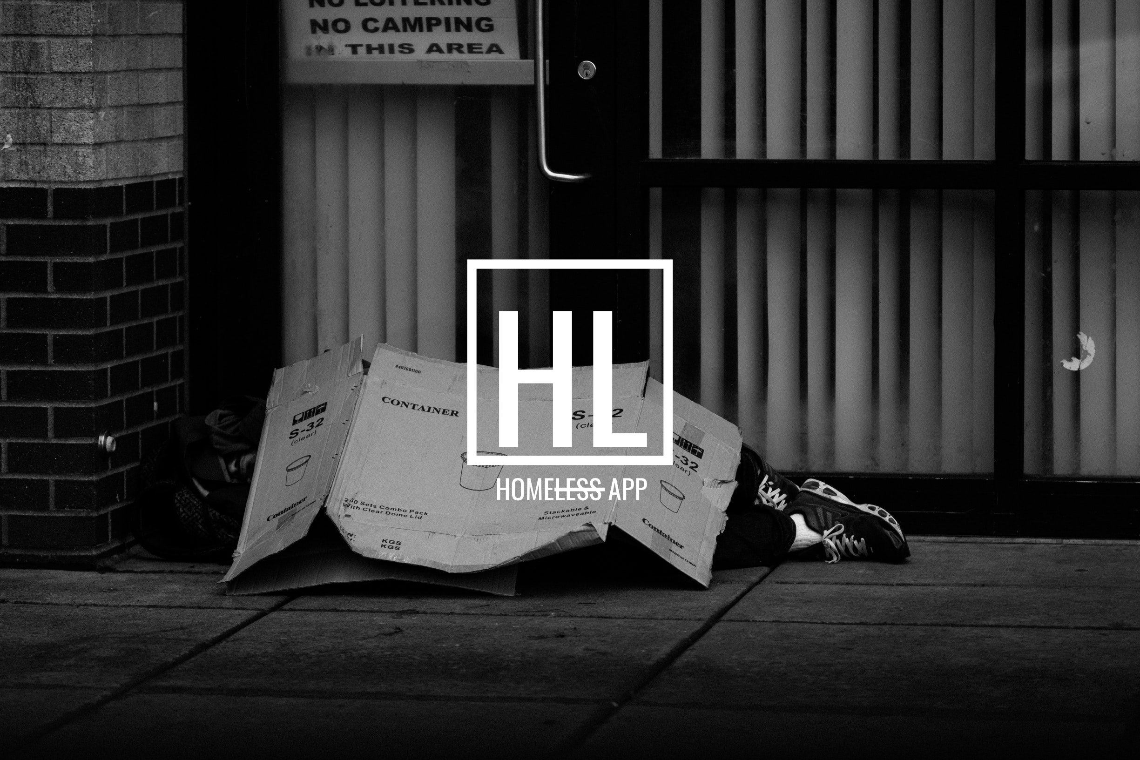


Notes:
Quote

Slide 2
TAKING THE LESS OUT OF HOMELESS
Notes:
Tagline.

Slide 3

I AM HOMELESS BUT I AM NOT LESS,
I AM MORE.
Notes:
Tagline.

Slide 4
SENSITISE OUR COMMUNITIES.
Brought to you by Homeless App Team.
Notes:
Problem.
To change the way people see the homeless community in Namibia.
We found that there is no actual Data on homeless community in our country.
They face a lot of problems with regards to living area, and access to the basic needs of any human being as well as Battling stigma from the community.

Slide 5
WE WANT TO IMPLEMENT A REWARD SYSTEM.
Brought to you by Homeless App Team.
Notes:
Solution.
We want to introduce a reward system instead of using money, they can earn points which they can then can use to claim a food or shelter from partners registered with us, this reduces the risk of purchasing narcotics.
So our App/Reward system will first begin by documenting the homeless community providing them with ID cards with QR codes.
A registered homeless individual can now be approached by the community members as they are verified, before they are given a vocational job.

Slide 6
WHY USE HOMELESS APP?
Brought to you by Homeless App Team.
Notes:
Unique Value Proposition
Government:
a platform for Statistics
Empowers the homeless to find employment
Community:
This app Idea will involve the community members and verify a homeless individual looking for a job and this decrease security risk as they can be verified.
The Homeless Community
They Will be able a play a role in society, where they can feel accomplished.
The card acts as small wallet only the to the individual whose face is on the card.

Slide 7
THE ECO-SYSTEM NEEDED.
THE COMMUNITY
THE HOMELESS COMMUNITY
SHELTERS, FUNDERS & PARTNERS
Notes:
UVP
We need The Homeless Community, The Community Members & Homeless Shelters, Funders and Partners.

Slide 8
TECHNICAL ECOSYSTEM
COMMUNITY
PARTNER STORES & SERVICES
DONATIONS
HOMELESS COMMUNITY
MANAGEMENT ACCOUNT
FUNDING
HOPE
EMPLOYEES
Notes:
UVP
We need The Homeless Community, The Community Members & Homeless Shelters, Funders and Partners.
The Management Account is the yhe NGO that will take on the project.
This is give a visual representation of the stakeholders involvement the ecosystem.

Slide 9
HOMELESS CENTRE
REHABILITATION
COUNSELING
REGISTERATION
FEEDBACK
Notes:
UVP
We need The Homeless Community, The Community Members & Homeless Shelters, Funders and Partners.

Slide 10
MOBILE APP
ADVERTS
ADVICE, FEEDBACK & TIPS
NOTIFICATIONS
VERIFICATION
DONATE
Notes:
UVP
We need The Homeless Community, The Community Members & Homeless Shelters, Funders and Partners.

Slide 11
WALVIS BAY YOUTH FEED THE HOMELESS
By Taati Niilenge | namibian.com.na
HELPING THE HOMELESS
erongo.com.na
Notes:
These are some of the people we would love to engage as the homeless app team.
A story covered in October of 2018 by Erongo.com shared how a learner by the name Darryn Booysen http://www.erongo.com.na/news/helping-the-homeless-2018-10-15
Helping the homeless, aimed at helping people who are homeless, get off the streets…fast forward to 2019 an article written by Taati Niilenge, covered a story about https://www.namibian.com.na/190828/archive-read/Walvis-Bay-youth-feed-the-homeless, We are already seeing that the youth are aware of the problem, they are trying to help.

Slide 12
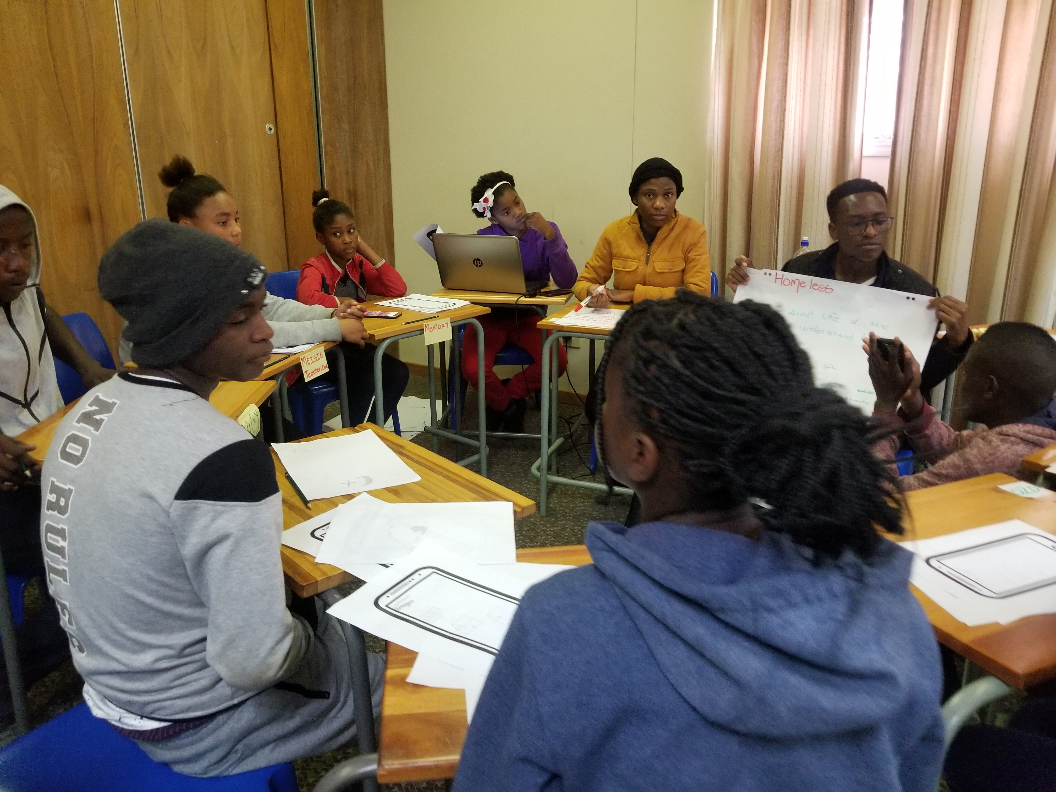
THIS IDEA WAS CO-DESIGNED WITH THE YOUTH IN THE COMMUNITY
Notes:
Traction
We began this whole process by co-designing the mobile app with the youth of Walvis Bay, We still in prototyping phase and we have not yet gone back to the community in Walvis Bay to act on our solution, but with backing we hope to make this solution go beyond Walvis Bay.

Slide 13
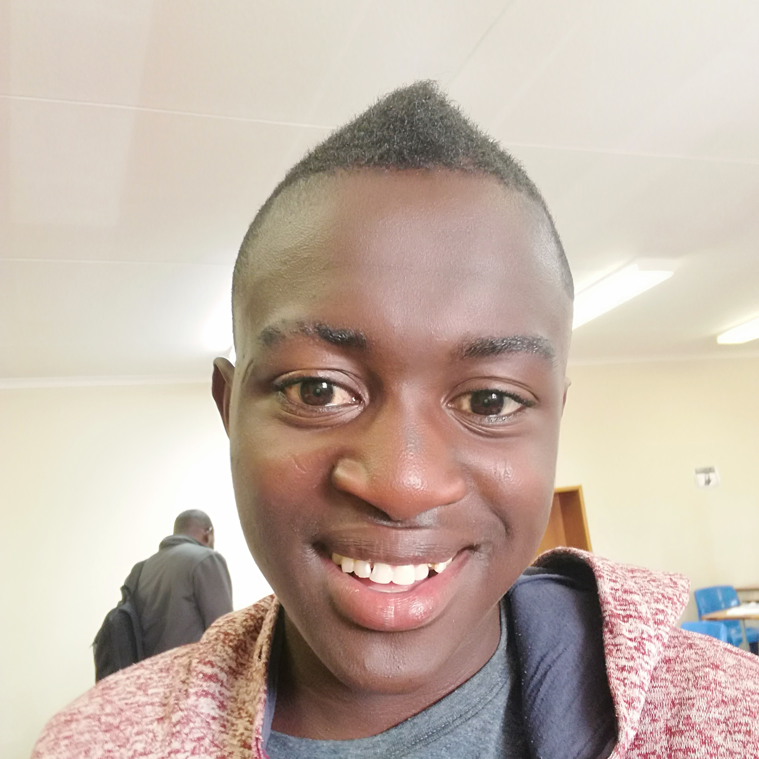
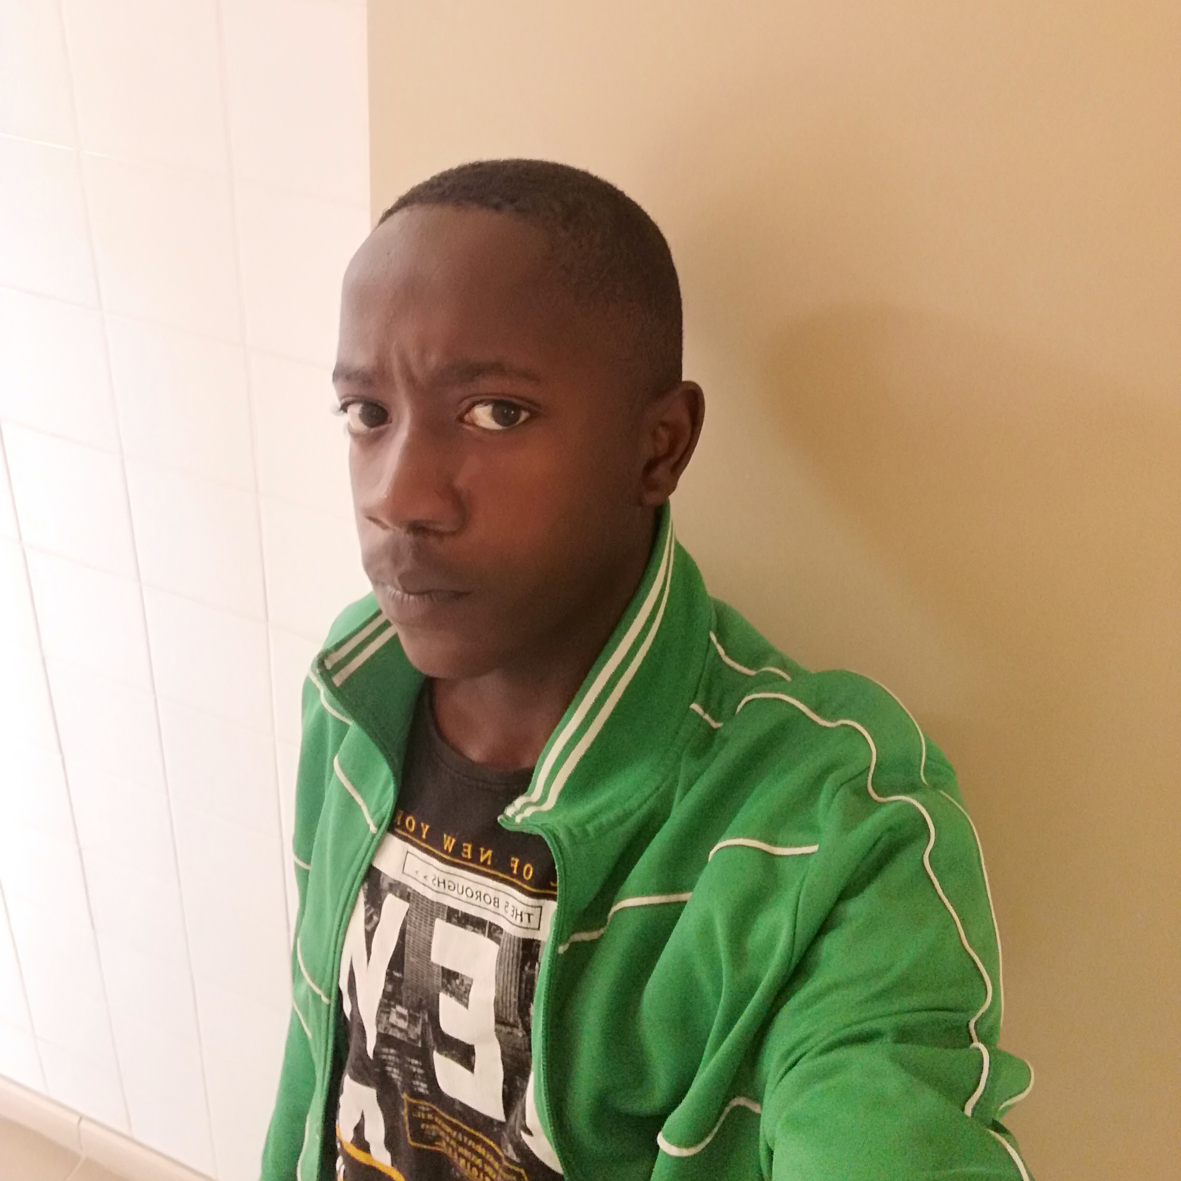
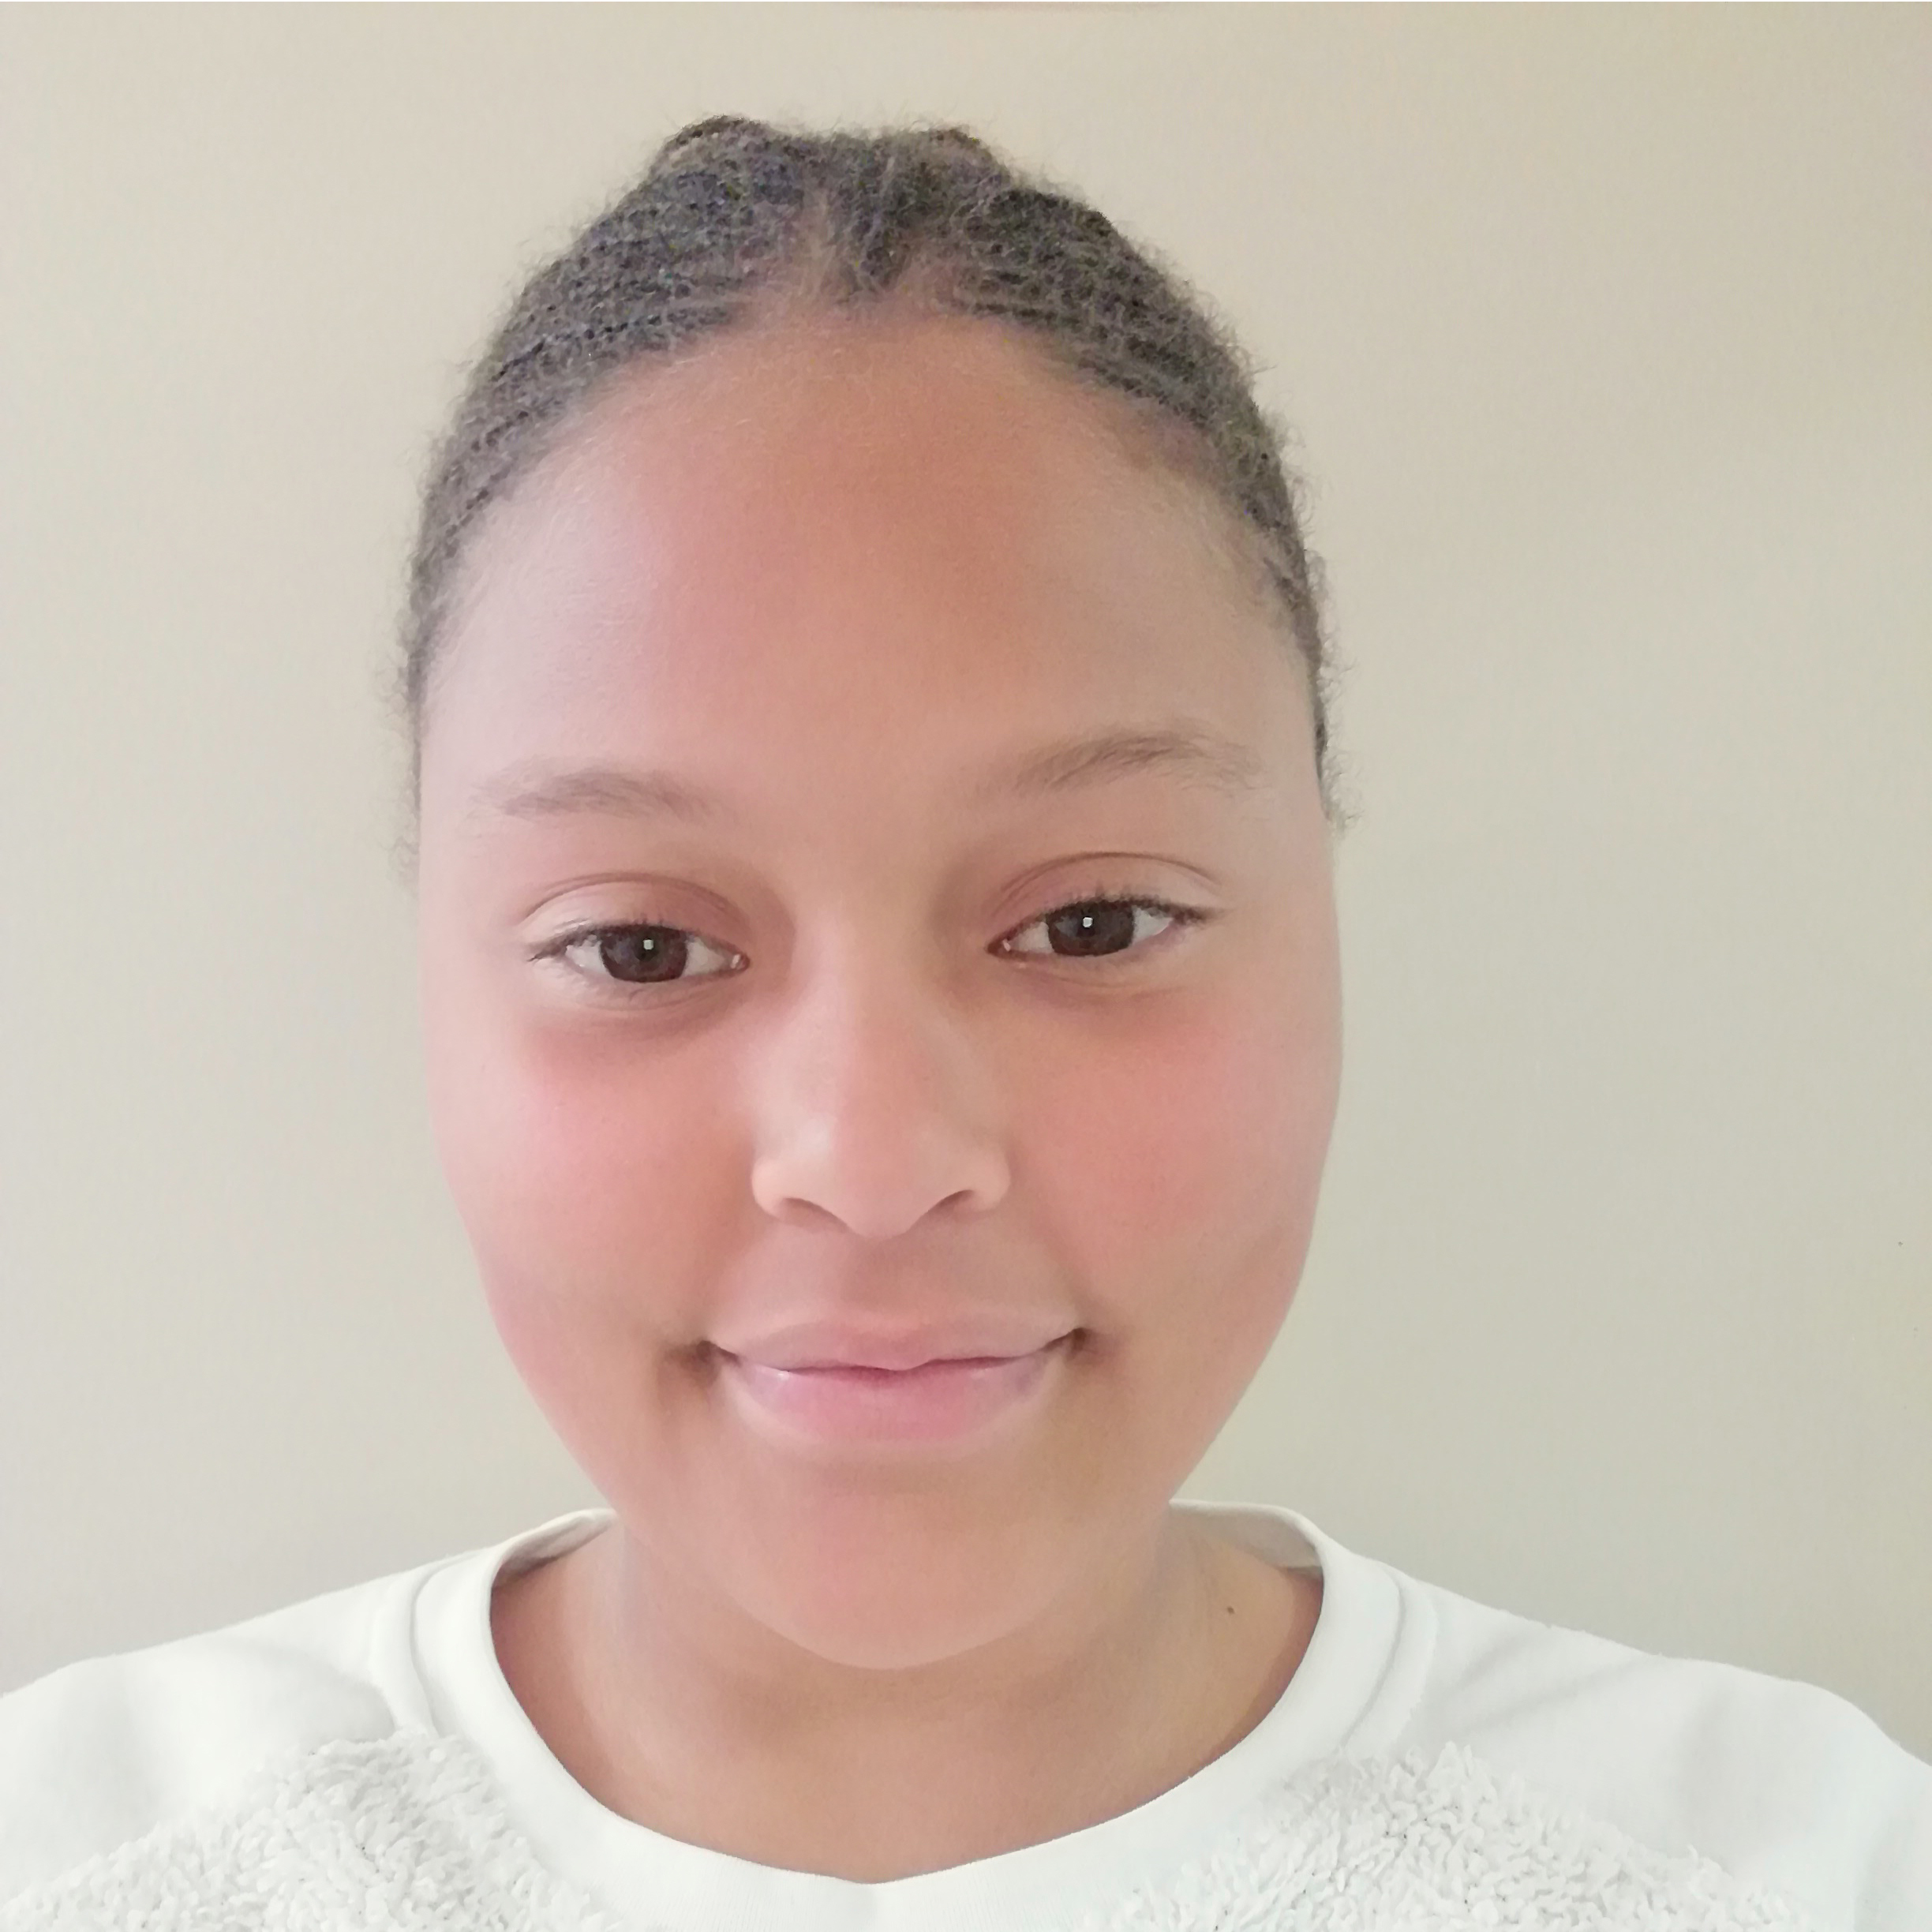
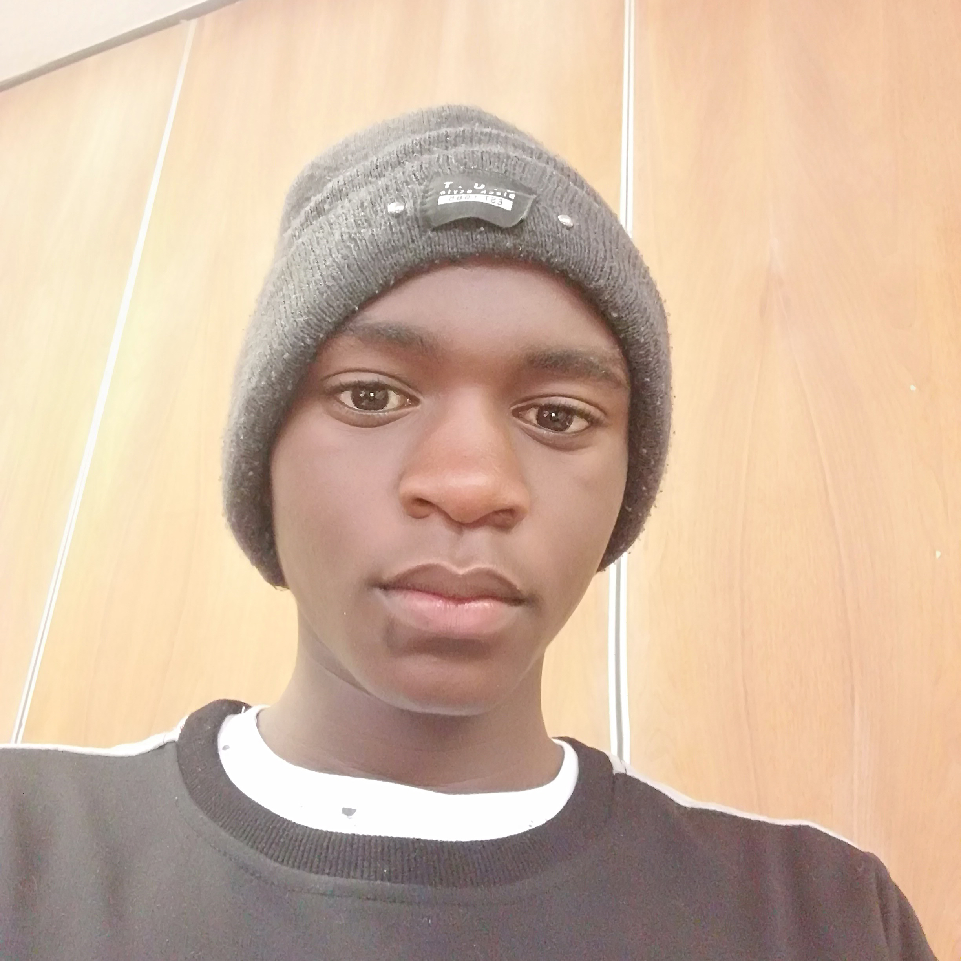

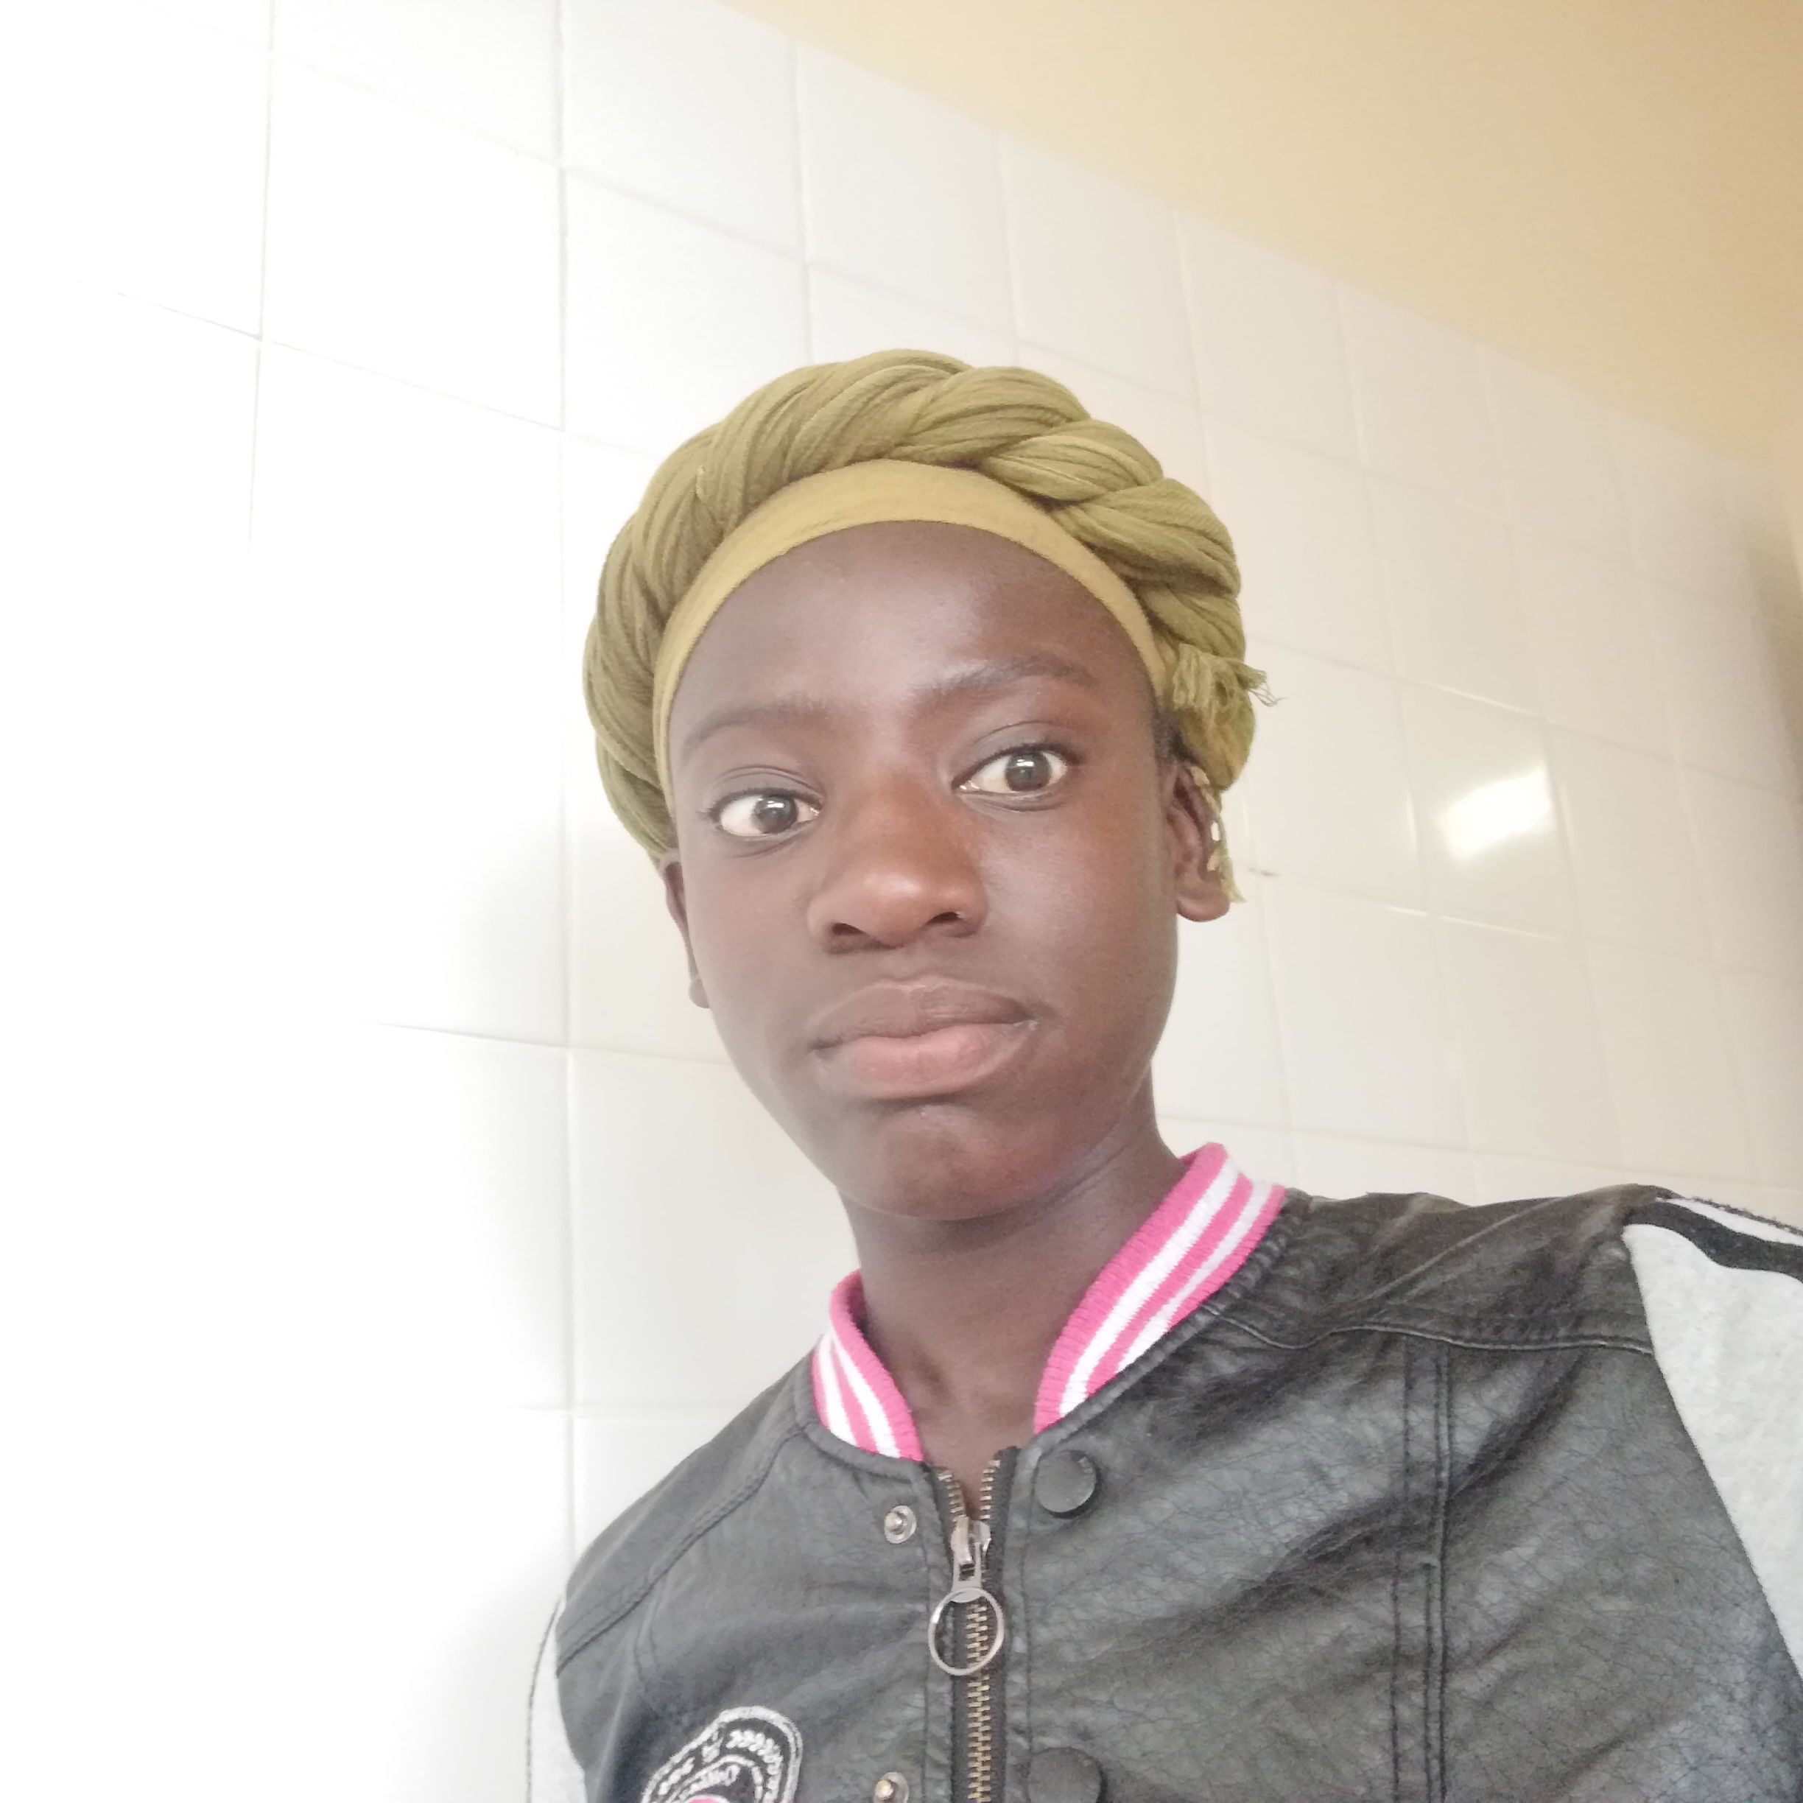
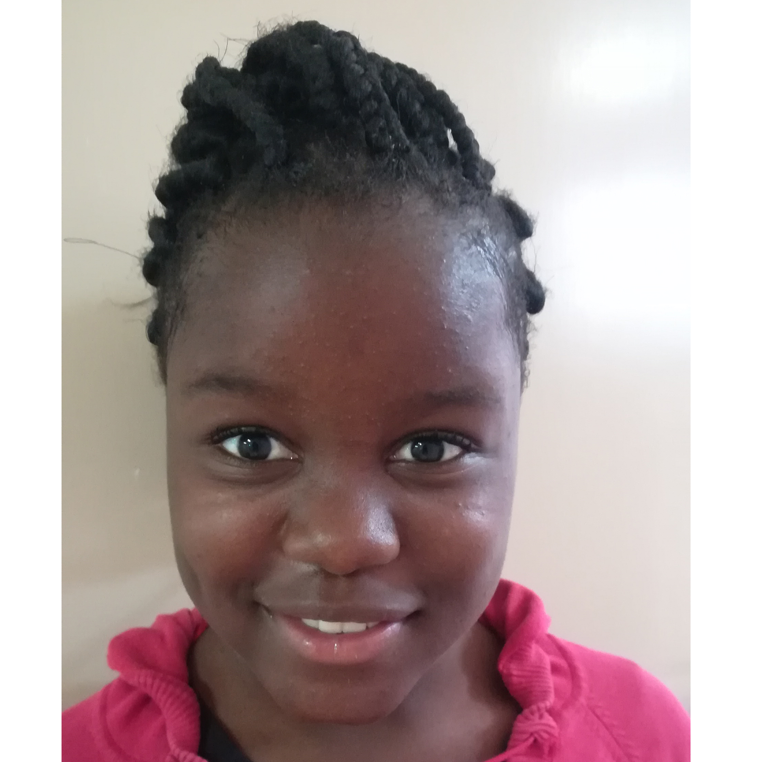
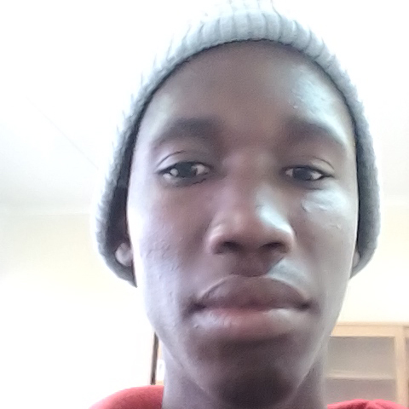
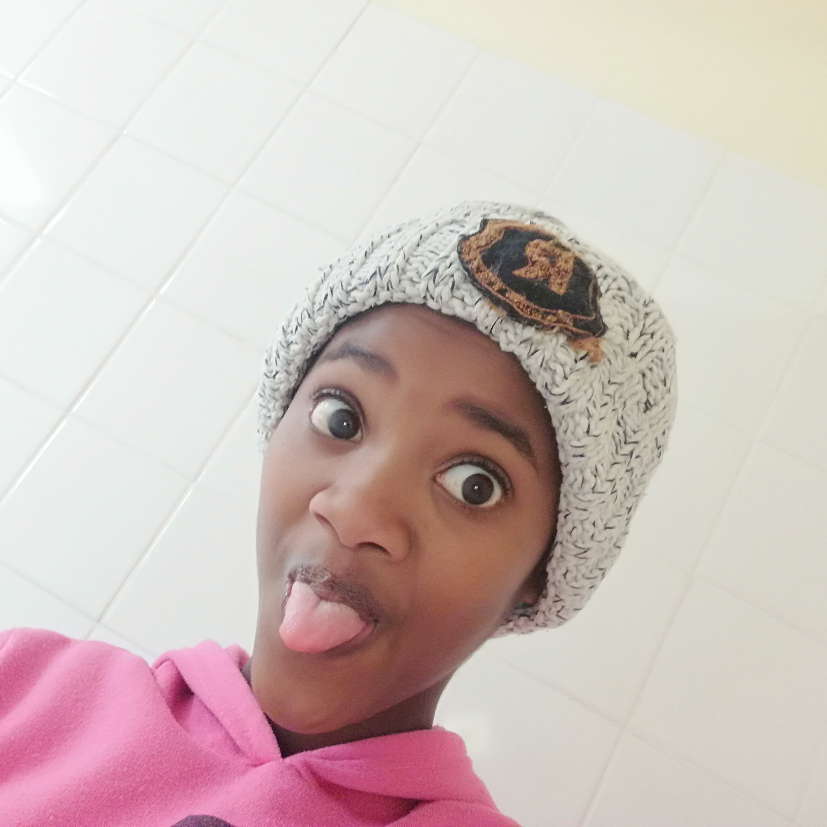
OUR TEAM.
YOUR
DREAMS
ARE VALID.
Notes:
Team
Firstly the team was made up of 9 youth from the Walvis Bay and Swakopmund Area during a project funded by the ICTechHub and their representatives are here Eugene & Lucia & My Name is Daniel Mgawi, I am a Graphic Designer & a 3rd Year at NUST Studying Software Development.

Slide 14
LASTLY.
WE NEED FUNDERS
AND DEVELOPERS
PARTNERS
WE NEED YOU!
WE NEED PEOPLE WHO WANT TO HELP PEOPLE.
Notes:
Ask.
We need Funders to sponsor they initiatives.
Partners to open their doors to the homeless app beneficiaries.
And Developers to helping improve the system/app.

Slide 15
Notes:
FAQ?
How do you inform the home community about this app?
Banners and Posters, around the Area, and By Having outreaches and Radio Talks about the system.
How do you pay for the things claimed with the points?
Sponsors and Funders, money will be paid straight to the business owners
Where can people claim the rewards?
We want Community members and local business owners to play are role.
Is there a limit to how long the points exist?
We need to Discuss Further
If I earn more points then others wont that be unfair as ill get all the jobs?
If you are earning more points, I felt that would mean we have succeeded in creating a environment for someone's rehabilitation in the community, someone who can help promote the benefits of this system.
Why we need the app to exists?
It’s a source of information and a means of verification that community members can use.

